Slide 1
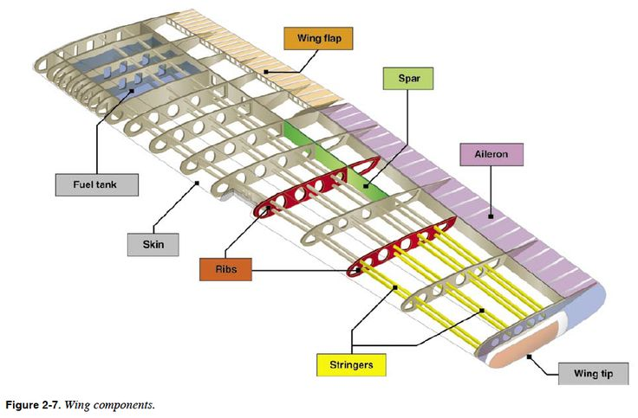
Design of a sailplane with a semi-monocoque wing
II. Structural Design and Material Selection
Senadheera H.W.M.L.U.C
230593A
1

Slide 2
Structural Idealization & Concept
Aerodynamic Baseline:
Wingspan: 15 m
Taper Ratio = 0.8
Root Chord = 0.694 m
Tip Chord = 0.556m
Structural Concept: Two-spar semi-monocoque wing box.

Slide 3
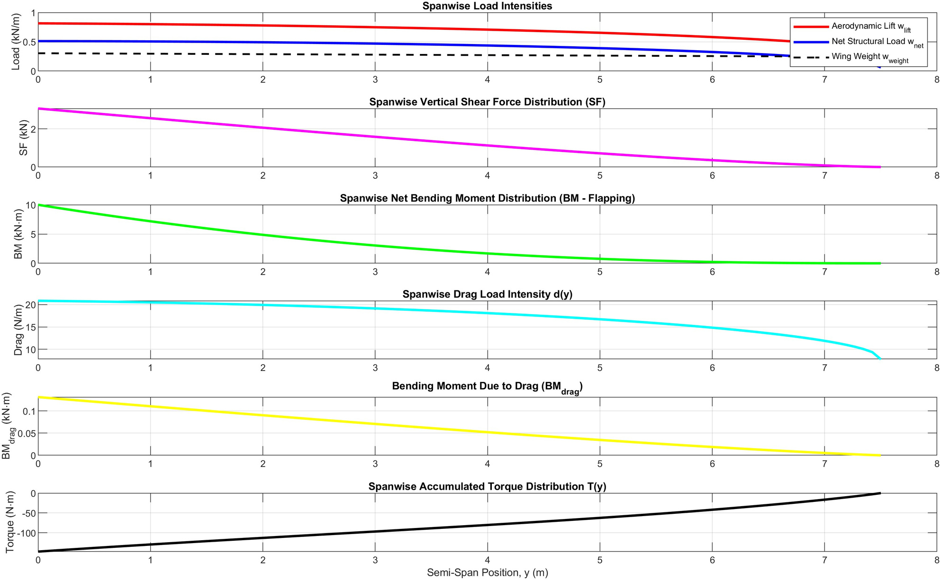
Spanwise Aerodynamic & Structural Loading

Slide 4
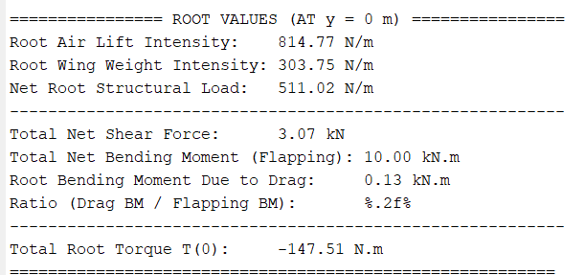
Spanwise Aerodynamic & Structural Loading

Slide 5
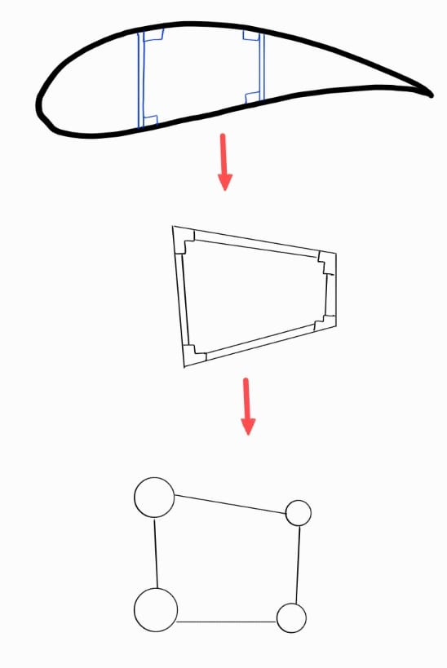
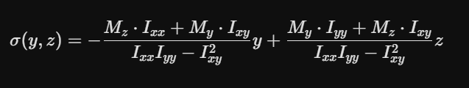
Wing Box Idealization
Boom Area Calculation
Assumptions
The direct stress due to bending moment is totally carried by booms (mainly spar caps)
Shear load is carried by the skin and the webs
Euler-Bernoulli beam theory
Booms

Slide 6


Boom Area Calculation
The My (Due to drag ) is very small compared to Mx due to vertical forces.
Therefore, the My is neglected in the calculation.
If Ixy =0 ,
Euler-Bernoulli beam theory equation get simplified as follows;

Slide 7
Boom Area Calculation at Root of the Wing
Objectives
Determine the location of spars and boom areas,
To minimize the spar cap area
To make Ixy = 0
Maximum deflection of the tip = 5% of wing span = 750mm
Range considered to place the front spar : 10 % - 30 % (Respective to the chord length)
Range considered to place the front spar : 40 % - 80 % (Respective to the chord length)
Minimum wing box separation : 20% (Respective to the chord length)
Note : Upper spar caps at compression and lower spar caps at tension.

Slide 8
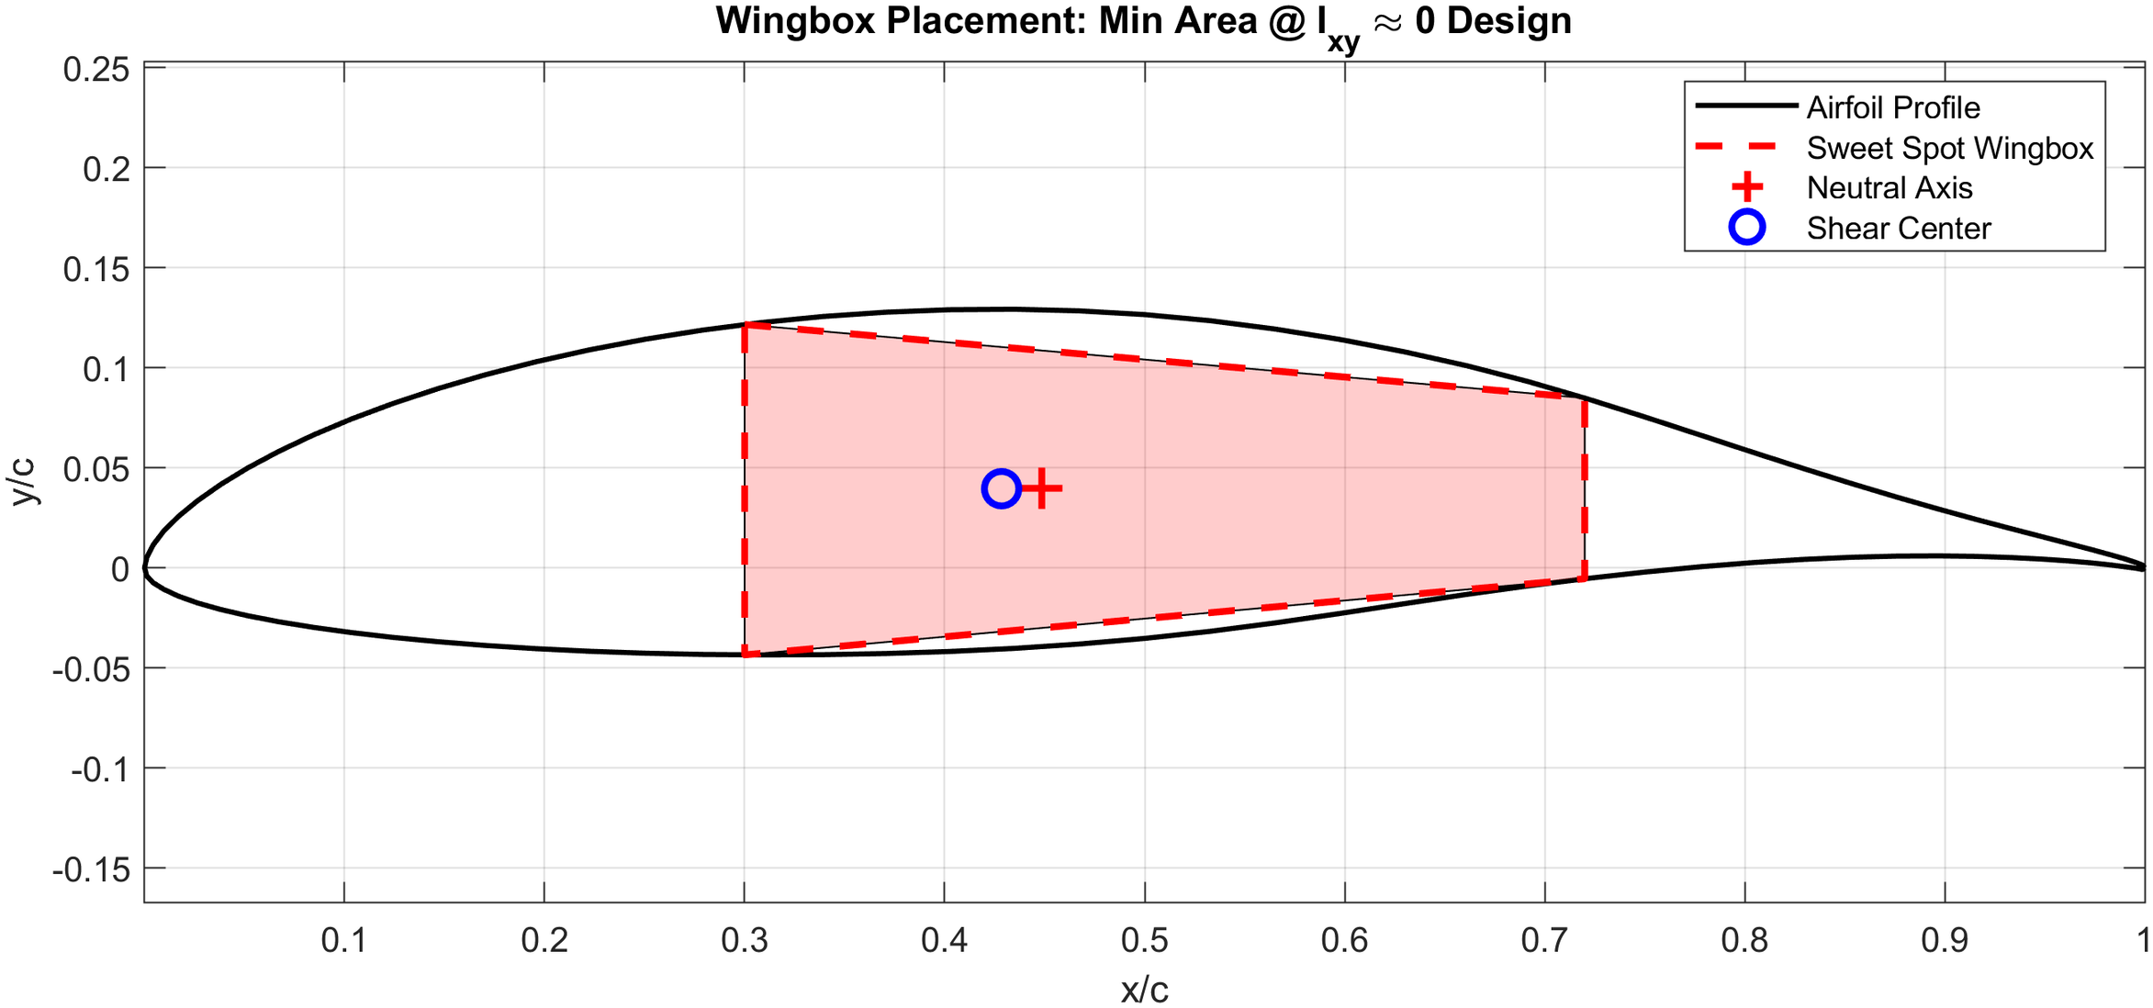

Slide 9
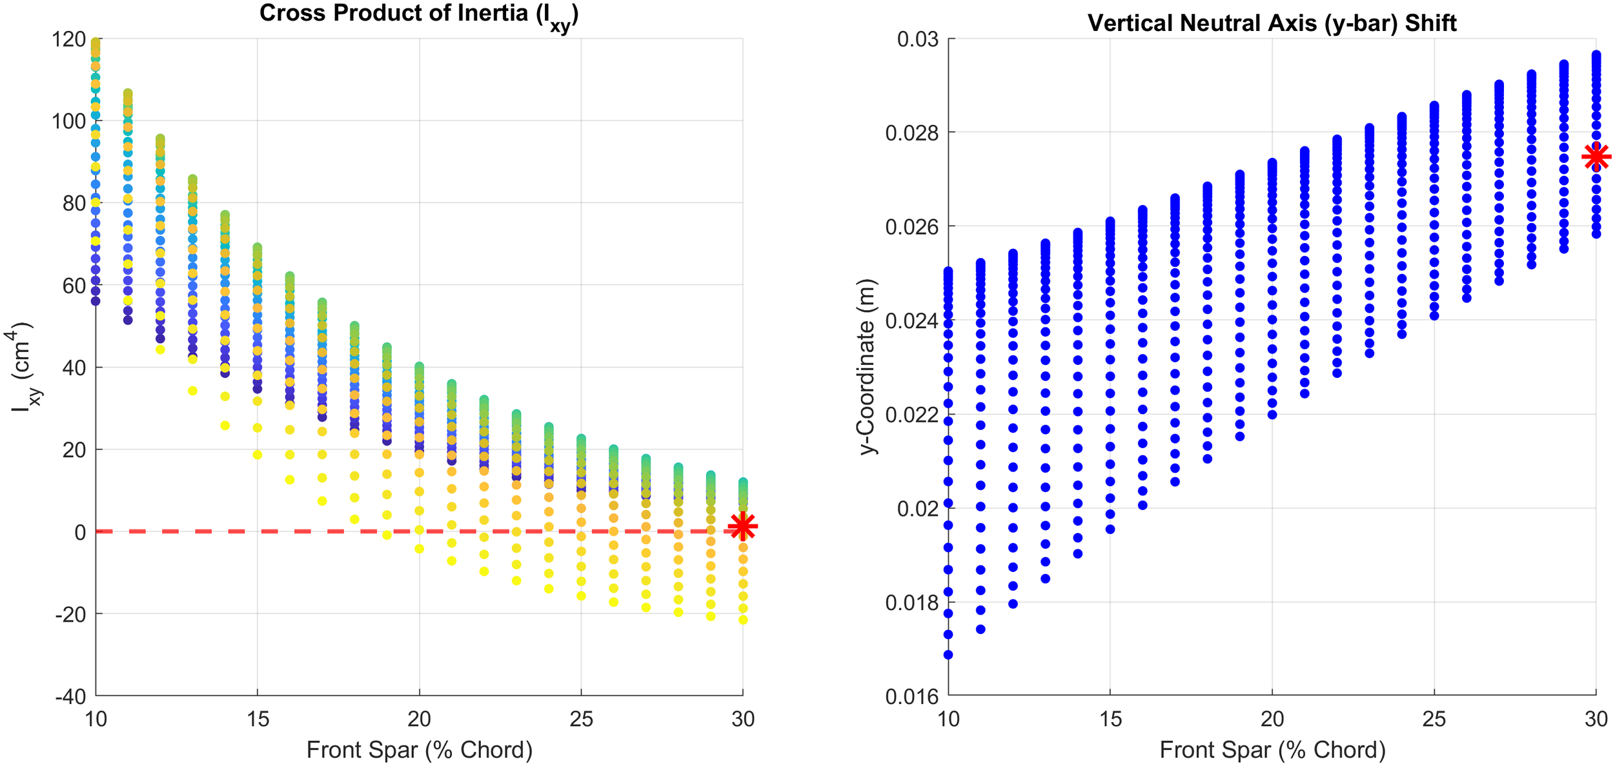

Slide 10
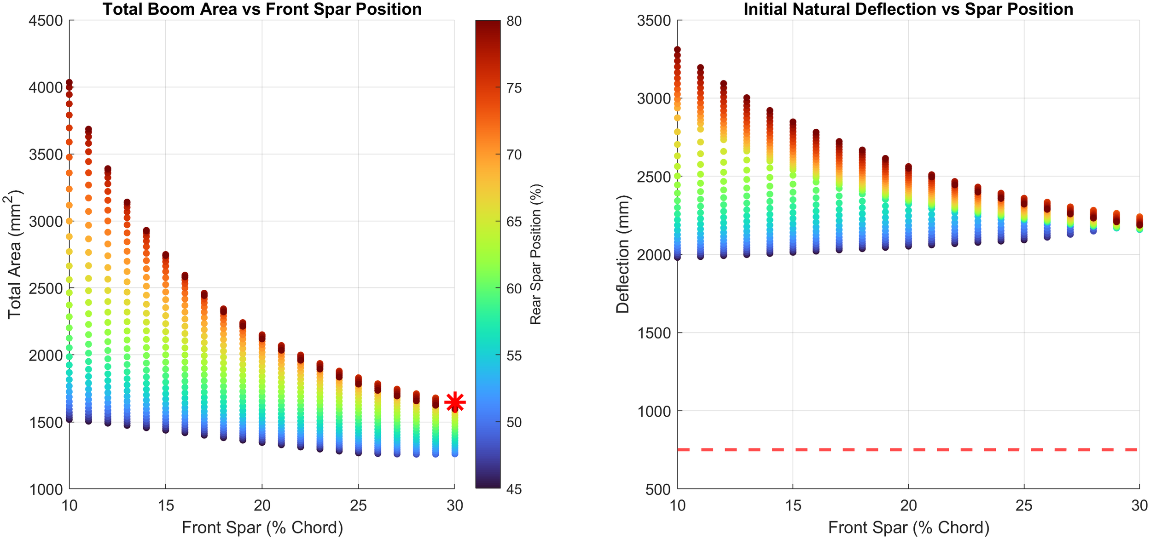

Slide 11
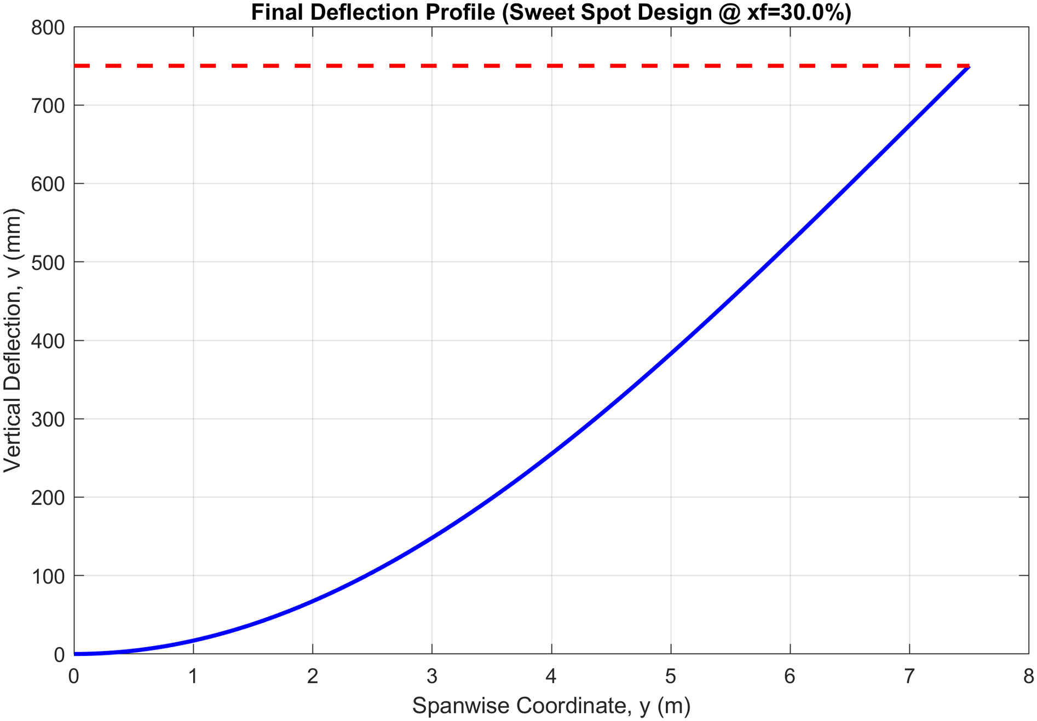

Slide 12
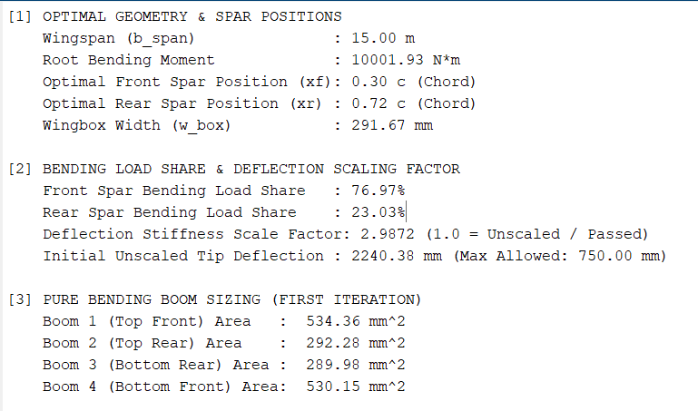

Slide 13
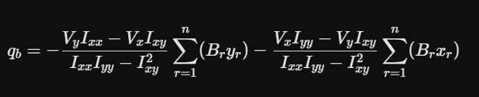
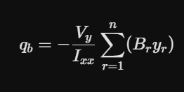
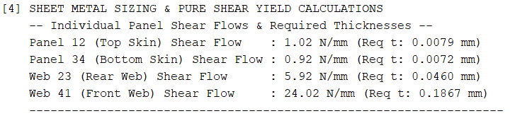
Skin and Web Sizing
The skin and webs carries the pure shear
Thin walled theory
Ixy = 0
Shear force due to drag is neglgible

Slide 14
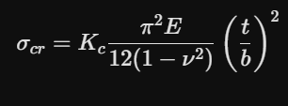
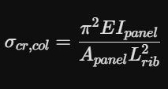
Ribs and Stringers
Skin Buckling
Calculated using flat-plate buckling formulas dependent on the panel aspect ratio (a/b, where a = Lrib and b =b , skin thickness (t), plate width, and buckling coefficients (Kc for compression, Ks for shear):
Stringer Buckling & Crippling
Treating the stringer plus an effective width of attached skin (beff) as a column of length Lrib, checked using Euler column buckling with its combined area moment of inertia (Ipannel):

Slide 15
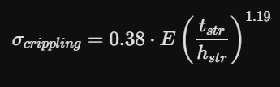
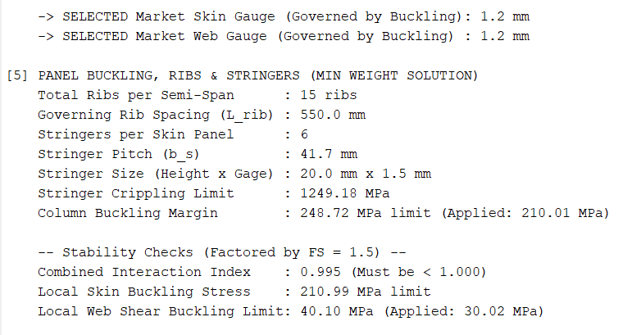
Local buckling of the stringer's own thin flanges (Z-section flanges) before the overall column fails, calculated using empirical geometric ratios:

Slide 16
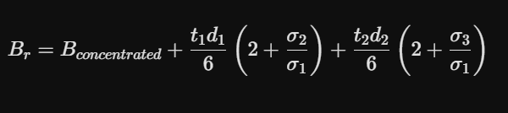
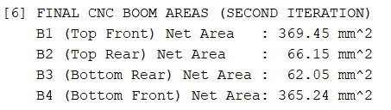
Finalizing the capsizing

Slide 17
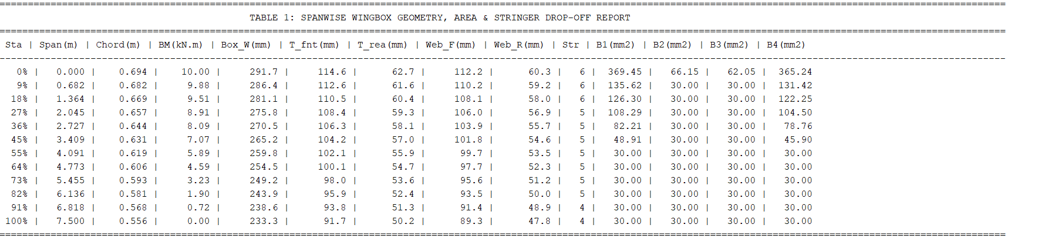
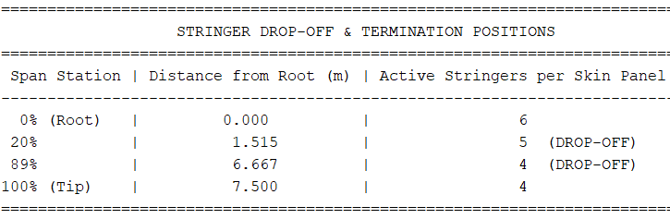

Slide 18
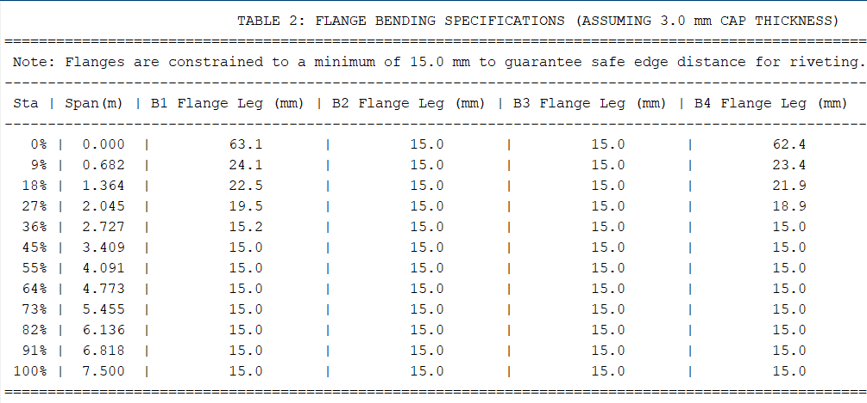

Slide 19
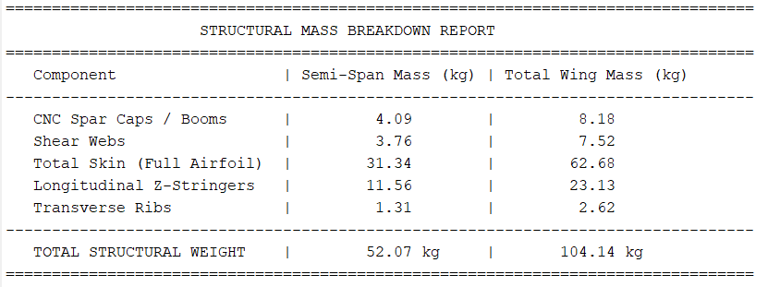
Mass of Sail Plane = 275 kg
Maximum possible wing mass = 110kg

Slide 20
Materials
Wing Skins & Shear Webs
6061-T6 Aluminum Alloy
High formability for wrapping complex airfoil contours
Excellent resistance to shear and torsional loads
Low weight with high corrosion resistance
Density : 2700 kg/m3
Shear Yield Strength : 193 MPa
Tensile Yield Strength : 276 MPa
Elastic Modulus (E): 68.9 GPa
Spar caps, Stringers, Ribs
7075-T6 Aluminum Alloy
High static strength-to-weight ratio
High resistance to local column buckling
Yielding under severe 3.8G load factors.
Density : 2810 kg/m3
Tensile Yield Strength : 635 MPa
Compressive Yield Strength : 630 MPa
Elastic Modulus (E): 71.7 GPa

Slide 21
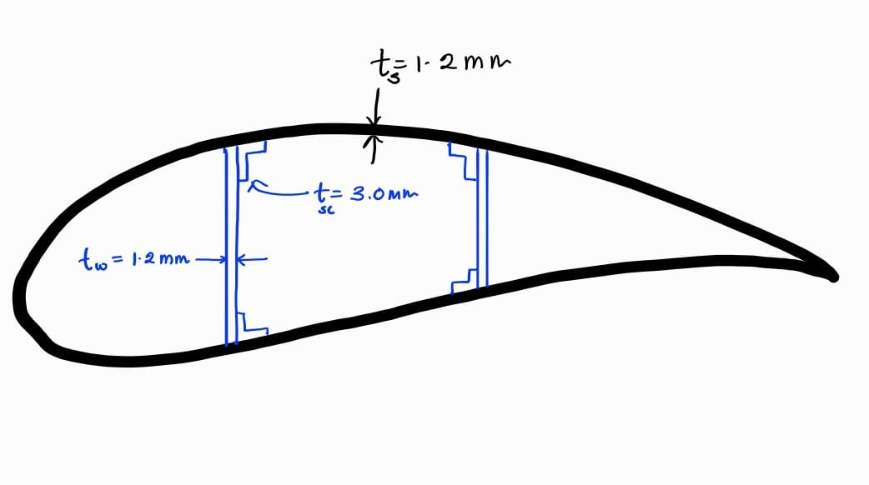

Slide 22

References

Slide 23
THANK YOU

